Slide 1
Movie Info Database

Slide 2
Elevator pitch

Slide 3
Concept
Description:
The website will allow users to search for a movie and get information about that movie along with some gifs related to the movie’s title.
Motivation for development?
User Story:
As an average movie-goer, I want a website that shows me information about the movies I’m interested in.

Slide 4
Process
Technologies used:
HTML, CSS, Javascript, GIPHY and OMDB APIs, TailwindCSS framework
Breakdown of tasks and roles:
Eduardo worked on the HTML frameworks
Channchealy worked on the CSS
Joshua worked on the Javascript
Challenges: Odd back-arrow interactions with gifs
Successes:

Slide 5
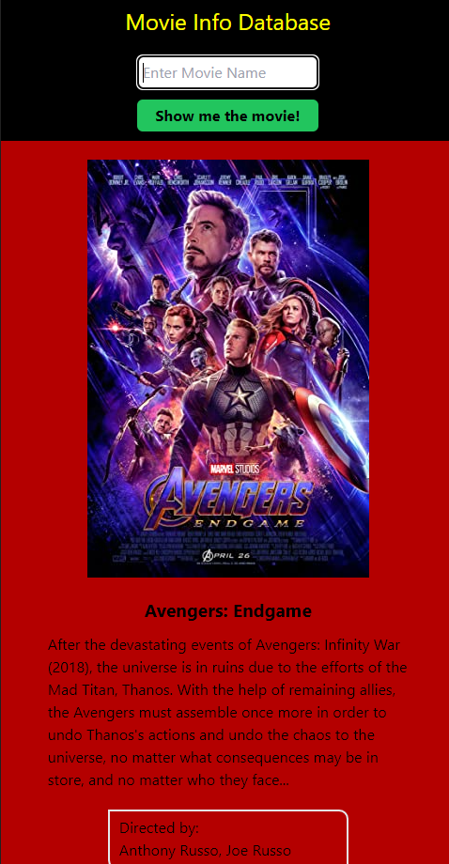
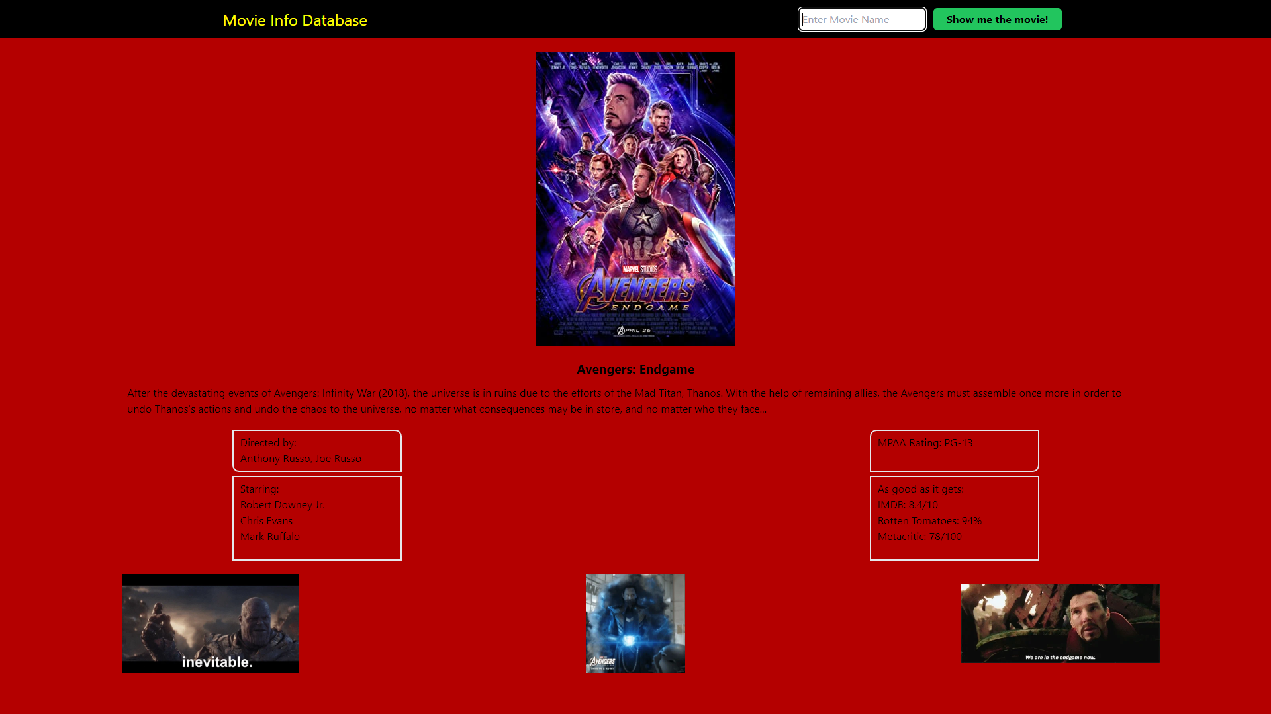
Demo

Slide 6
Directions for Future Development
In the future we’d like to ensure that the gifs are 100% related to / from the movie the user searched for. This is already largely the case, but we’d like to expand this to cover the few outliers.
Prior to searching for a movie, the webpage is largely blank. Ideally, we would have a slideshow banner displaying current popular movies the user could interact with to pull up information on those movies.

Slide 7
Links
https://indy6678.github.io/movie-info-db/
https://github.com/indy6678/movie-info-db/

